Slide 1
Banking Management
System
Menu driven application

Slide 2
Aim
The bank management system is an application for maintaining a customer’s account in a bank.
The system provides the access to the customer
-to create an account,
-deposit/withdraw the cash from his account
- view reports of all accounts present

Slide 3
Requirements
Mysql workbench for database connection
Vscode to write code
Languages:
-python
-mysql
Operating system windows 10

Slide 4
Module description
Module Name | Description
Open Account | Opens new account by accepting customers details.
Update details | Update new details of customer
Transaction and close balance | Customer perform transactions like withdraw amount. Also check transaction details and balance.

Slide 5
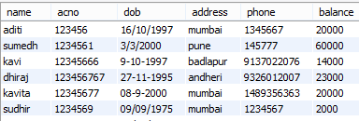
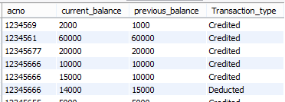
Snapshots
Account table
Amount table

Slide 6
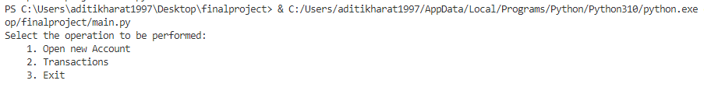
After running main file:

Slide 7
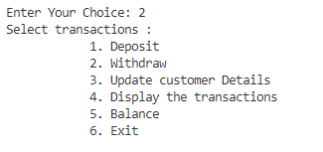
Transactions

Slide 8
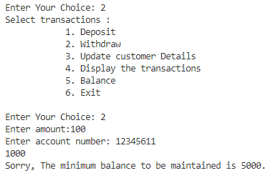
Userdefine function

Slide 9
Thank You…

